Slide 1
Innovative Rate Designs: Maximizing the Value of AMI
A review of innovative Rates for mass market customers
Presented By
  Sanem Sergici
  Goksin Kavlak
  Sai Shetty
Presented To
  AMS Advisory Group
July 10, 2023

Slide 2
Objectives of Today’s Meeting
  Review rate design principles and tradeoffs
  Review alternative rates that could be tested in the EPE’s Time Varying Rate (TVRs) Pilot
  Understand initial stakeholder preferences for TVRs to be tested in the pilot

Slide 3
Meeting Agenda
Rate Design Principles and Tradeoffs
Alternative Rate Designs for Mass Market Customers
    Time-of-Use
    Critical Peak Pricing
    Peak Time Rebate
    Variable Peak Pricing
    Real-time Pricing
    Fixed bill with incentives (Subscription plus)
  3. Designing EPE’s TVR Pilot

Slide 4
1- Rate Design Principles and Tradeoffs

Slide 5
The utility cost structure has three primary components
Energy-Related
Vary with kWh of energy generated
Demand-Related
Vary with the kW of instantaneous demand, peak capacity
Customer-Related
Vary with the number of customers
What are the costs to provide an additional kWh of energy?
Fuel, wholesale purchase power
What are the costs to add capacity?
Generation, transmission and distribution capacity
What are the costs to add an additional customer?
Meters, service drops, poles, billing and customer care
Variable Costs
Fixed Costs

Slide 6
There is misalignment between how utility costs are incurred and how they are recovered from customers
The typical residential customer’s bill does not match the utility’s underlying costs
In the example, the variable kWh charge recovers not only the $60 of variable costs, but also $55 of the fixed costs…
…but a utility does not avoid embedded/fixed costs when a consumer reduces its usage
This is problematic and is at the heart of many discussions in rate design and electricity policy
Utility’s Costs
Customer’s Bill
Variable = $60
Fuel/gas supply
Variable O&M
Variable = $115
kWh charge
Fixed (Customer) = $10
Fixed (Demand) = $50
Generation capacity
Distribution capacity
Transmission capacity
Customer = $5
Monthly charge
Notes:
Current residential delivery rates typically have two components to recover a multitude of utility service costs: fixed charges and volumetric rates
An ideal rate structure would attribute a separate charge to address each of the cost categories. However, as much as rates should promote economic efficiency and equity, the complexity of the rates should be balanced against their likely customer understanding

Slide 7
This paradigm is not sustainable; rate design is ripe for change
Problems caused by the volumetric rate structure have become too big to ignore
  Rising peak loads and falling sales lead to under-recovery of costs
  DERs will continue to exacerbate the mismatch between revenue and costs among residential customers
Regulatory pressures are mounting
  Push for increased DER penetration, greater customer choice, and greater system efficiency
Customer needs are changing rapidly
  Seamless integration of technologies with the grid at the same level of reliability they have today
  Expect more rate options that will match their usage preferences

Slide 8
Primary Mission of Retail Pricing
Primary function of retail rates is to recover the utility’s revenue requirement in the most economically efficient and equitable fashion
At the same time, rates should reflect the structure of the costs incurred to serve them and lead to efficient price signals to:
  Encourage optimal consumption decisions;
  Lead to bill stability for customers and revenue stability for utilities; and
  Be easily understandable by customers
When the rate construct is laden with other objectives, such as incentivizing new technology adoption and subsidizing certain customer groups, rates may lead to inter- and intra-class cost shifts and convey inefficient price signals that lead to over- or under-consumption of electricity

Slide 9
Rate Design Principles
Rate design should adhere to well-known rate design principles
Principles |  | Objective
1 | Cost causation | Rates should reflect cost causation, including embedded costs, long-run marginal and future costs, and the fixed cost nature of delivering electricity
2 | Encourage efficient outcomes | Rates should encourage economically efficient and market-enabled decision-making, for both efficient use of the grid by customers and new investments
3 | Fair Value | Customers and utility should both be paid the fair value for the grid services they provide
4 | Customer Orientation | Rates should aspire for simplicity while providing customer choices
5 | Stability | Customer bills should be relatively stable
6 | Access | Electricity should remain affordable and accessible for vulnerable sub populations
7 | Gradualism | Rate changes should be implemented in a manner which would not cause any large bill impacts
8 | Economic Sustainability | Rate design should reflect a long-term approach to price signals, remain neutral to any particular technology or business cycle and avoid cross-subsidies and prevent abuse/gaming/arbitrage
Cost
Reflectivity
What is the maximum acceptable change in customer bills during the transition to more cost-reflective tariffs?
At what point is a cost-reflective tariff too complex for customers to understand?
Bill Impact
Simplicity/
Acceptability
Do simple tariffs lead to significant over/underpayment by certain customer segments?

Slide 10
Customers have diverse preferences
Some customers want the lowest price
  They are willing to be flexible in the manner in which they use electricity
Some want to lock in a guaranteed bill
  They are willing to pay a premium for peace-of-mind
Many others are in between these two bookends
  Some might want a fixed bill but may be willing to lower it if rebates are offered for reducing demand during peak periods
If the alternative rates are not appealing to customers, the most cost-reflective and most meticulously designed rates will not have many takers

Slide 11
There are various alternatives to standard volumetric rates, most of which are enabled by AMI
 | Definition
Time-of-Use (TOU) | The day is divided into peak and off-peak time periods. Prices are higher during the peak period hours to reflect the higher cost of supplying energy during that period
Critical Peak Pricing (CPP) | Customers pay higher prices during critical events when system costs are highest or when the power grid is severely stressed
Peak Time Rebates (PTR) | Customers are paid for load reductions on critical days, estimated relative to a forecast of what the customer would have otherwise consumed (their “baseline”)
Real-Time Pricing (RTP) | Customers pay prices that vary by the hour to reflect the actual cost of electricity
Two-Part Real-Time Pricing (2-part RTP) | Customer’s current rate applies to a baseline level of consumption. A second, more marginal cost based price applies to deviations from the baseline consumption
Variable Peak Pricing (VPP) | During alternative peak days, customers pay a rate that varies by day to reflect dynamic variations in the cost of electricity
Demand Charges | Customers are charged based on peak electricity consumption, typically over a span of 15, 30, or 60 minutes
Fixed Bill with incentives | Customers pay a fixed monthly bill accompanied with tools for lowering the bill (such as incentives for lowering peak usage)

Slide 12
Trends in rate design
  With the increased penetration of AMI, and the experience with time-varying rates, we see more jurisdictions introducing time-varying rates
  Most of these time-varying rates are in the form of TOU rates
  There is a trend toward large scale TOU rollouts; more jurisdictions are offering TOU as the default rate for their residential customers
  Newer TOU rates typically have shorter peak windows and prioritize customer experience
  More utilities are offering EV TOU rates that better incentivize efficient charging of the EVs; these TOU rates typically involve super off-peak periods
  In jurisdictions with high penetrations of solar, there are TOU variations with mid-day discounts to soak up the excess generation
  Subscription pricing is receiving more interest as utilities expand their menu of rate offerings to customers
  In many jurisdictions, NEM policies trigger a fresh look at rate design and TOU rates emerge as one of the ways to mitigate cost shifts
  There is interest in consolidating tariff books and offering customers several and meaningfully different options

Slide 13
2 – Alternative Rate Designs for Mass Market Customers

Slide 14
1- Time-of-Use (TOU) Rate
The day is divided into time periods which define peak and off-peak periods. Prices are higher during the peak period to reflect the higher cost of supplying energy.
Pros | Cons
Better captures the natural variation in the cost of supplying electricity to customers Helps raise load factors and lower average costs for all customers Reduces inter-customer cross-subsidies | Opt-in deployments create a revenue loss issue which has to be dealt with either through decoupling (California), a Lost Revenue Adjustment Mechanism (Oklahoma), or building the revenue loss into the TOU rate structure (Xcel Energy Colorado) There may be customer dissatisfaction with having to modify behavior to solve what customers essentially view as the utility’s problem Would raise bills for customers with peakier than average load shapes, who thus may not enroll even though they drive up costs for all customers. Meanwhile, customers with higher than average load factors may receive lower bills without changing their behavior, creating a revenue loss issue for the utility

Slide 15
2- Critical Peak Pricing (CPP) Rate
Customers pay higher prices during critical events when system costs are highest or when the power grid is severely stressed.
Pros | Cons
Just a few critical events can account for a high share of demand. For the typical utility, the top 1% of hours with the highest usage may account for 8%-18% of annual peak load, requiring peaking capacity to be kept idle at high cost to meet this contingency More responsive to changing conditions than TOU, allowing for more timely load reductions during critical events and reducing need for peaking capacity | Customers tend to become anxious just from looking at the high prices charged during the critical peak hours. While some respond, some will just drop out of the rate

Slide 16
3- Peak Time Rebate (PTR) Rate
Customers receive credits for load reductions during critical events, estimated relative to a forecast of what the customer would have otherwise consumed (their “baseline”).
Pros | Cons
Instead of charging a higher price during the critical hours, provides a rebate during those hours, which may be more appealing to customers The scarcity value of providing power during the critical hours is conveyed as an opportunity cost (lost opportunity for earning a rebate) and not as a higher price (CPP) Similar to CPP, more responsive than TOU in addressing extreme temperature events | In order to compute the rebate, the utility needs to know what the customer would have consumed if the rebate had not been given (i.e., estimate baseline usage) Since the price does not change in either the peak or the off-peak period, the PTR rate is not as cost-reflective as the CPP tariff or even the TOU tariff The source of the PTR payments becomes an issue to resolve for large scale deployments

Slide 17
4- Variable Peak Pricing (VPP)
During event days, customers pay a rate that varies by day to reflect dynamic variations in the cost of electricity.
Pros | Cons
More precise match of actual costs to customer prices May have four rates, for example Oklahoma has Low, Standard, High, Critical May be tied to real-time prices applicable on the event day Used with programmable thermostats would make it easier for customers to control heating | More complex for customers to understand and respond to on one day (or less) notice. In Oklahoma there are 86 days that customers are notified and one of the four prices is used.

Slide 18
5- Real-Time Pricing (RTP)
Customers pay prices that vary by the hour to reflect the actual cost of electricity.
Pros | Cons
Hourly variation in energy prices passes through variations in wholesale energy markets to customers (often supplemented with a way to recover capacity costs), incentivizing customers to use less when prices are high and use more when prices are low The need for such a product will grow as more renewable energy resources are interjected into the resource mix of utilities. Renewable energy resources, mostly solar and wind, are intermittent, whereas RTP can inject load flexibility and ensure reliability | Bill volatility can be quite severe. To broaden its appeal, the RTP product would probably need to be redesigned to shield customers from massive bill volatility, for instance through price caps and collars

Slide 19
6- Fixed Bill with Incentives
Customers pay a fixed bill regardless of actual usage for a given term based on their “average” weather year consumption level.
Pros | Cons
Provides bill stability for the customer, which is appealing to customers who value consistent bills Designed to be revenue neutral to the standard rate offering Reduces annual variation in revenue collection and aligns more closely with the high fixed costs of the electric grid Can be coupled with incentives rewarding customers who maintain usage levels, and other add-ons for EE, DR, clean energy, and EV charging | Reduces price signals for customers Usage may increase straining the grid and harming energy efficiency goals Decouples revenue from actually incurred costs Offer is based on how much a customer would consume in an “average” weather year Depending on the weather, customers may consume more or less than the average leading to under- or over-collection

Slide 20
Different rate designs meet different objectives
Rate Design | Cost causation | Customer Orientation | Equity | Revenue Stability | Bill Stability
TOU | M | M | M | M | M
CPP | M | L | M | M | L
PTR | L | H | H | L | H
RTP | H | L | L | H | L
Three-part rate | H | L | L | H | L
Fixed bill with incentives | L | H | M | H | H

Slide 21
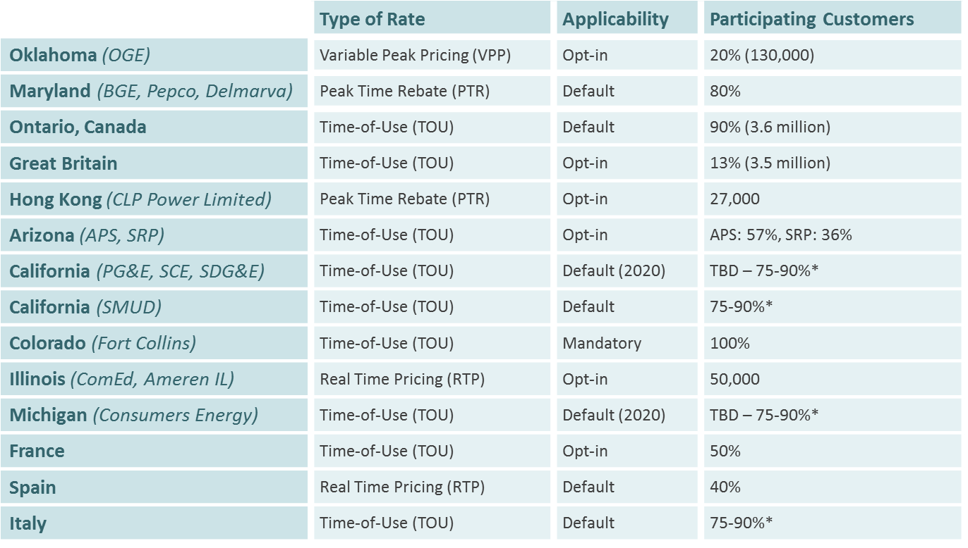
Residential TVRs have been deployed around North America and the rest of the world

Slide 22
There is a trend toward large scale TOU rollouts
The following utilities have or will transition to default or mandatory TOU, or otherwise have achieved high levels of opt-in participation
Default TOU (8)
  Ameren, California IOUs (SCE, PG&E SDG&E), DTE, LIPA, SMUD, Xcel Energy (CO)
Mandatory TOU (2)
  Consumers Energy, Fort Collins Utilities
Opt-in with high participation (2)
  Arizona Public Service, Salt River Project

Slide 23
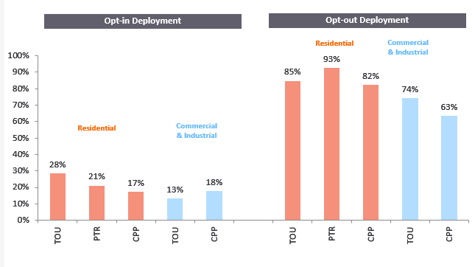
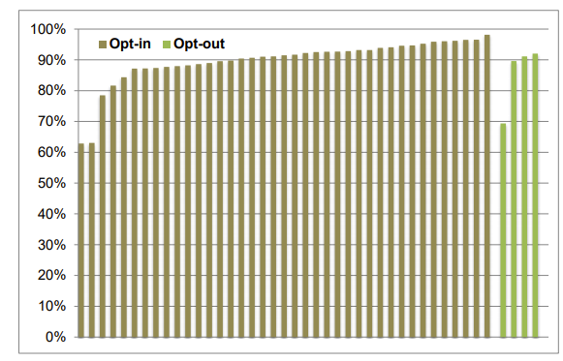
  While there are a handful of states offering default TVRs on a mandatory or default basis, TVRs are most commonly offered as opt-in rates at this time
Enrollment in Time-Varying Rates
(Average Across 6 Market Research Studies and 14 Full Scale Deployments)
Retention Rates by Treatment Type: Opt-in vs. Opt-out
  A DOE Meta Study (*) on 10 TVR pilots found that, while adoption and enrollment rates are lower under opt-in deployment compared to opt-out, retention is slightly higher
  (*)DOE LBNL, “Final Report on Customer Acceptance, Retention, and Response to Time Based Rates from the Consumer Behavior Studies , November 2016
  https://www.energy.gov/sites/prod/files/2017/01/f34/CBS_Final_Program_Impact_Report_20161107.pdf
TVR opt-in rates are around 20% for residential and 15% for C&I customers
TVR opt-out rates are around 85% for residential and 70% for C&I customers

Slide 24
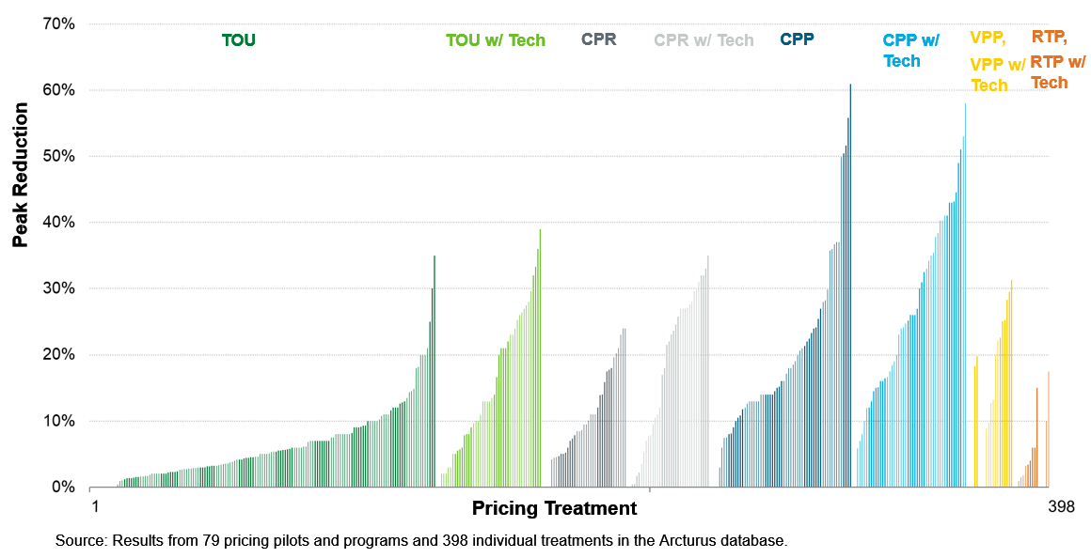
There is compelling evidence from ~400 treatments that customers respond to TVRs

Slide 25
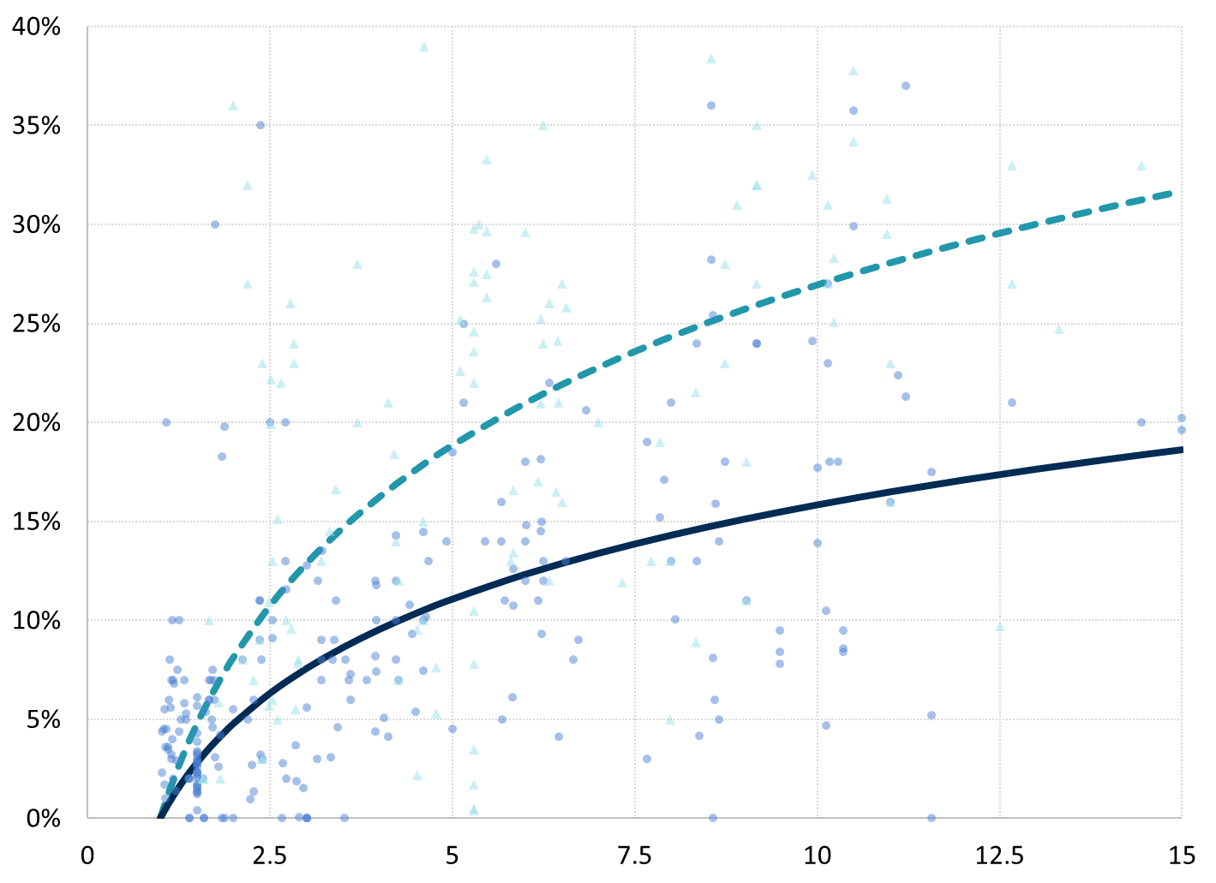
As the P/OP ratio increases, peak load impacts increase at a decreasing rate
Arc of Price Response: TVR Only vs. TVR+Tech/Info
  Using 387 treatments, we estimated a regression between Peak/Off-peak price ratios and peak impacts
  “Arc of Price Response” shows that the price responsiveness increases at a decreasing rate
  When TVRs are paired with enabling technologies and/or informational feedback, the peak impacts are higher than that of TVRs only
TVRs with Technology/Information
Peak Impact
TVR only
P/OP Ratio
Notes: Data from 74 pilots and programs and 387 individual treatments. RTP treatments are excluded.

Slide 26
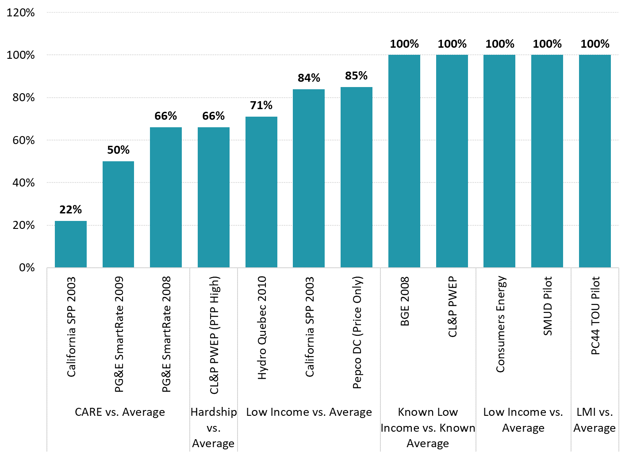
Low income customers respond to TVRs, in many cases as much as average customers
Whether the low income customers can respond to TVRs is a contentious question that come up in many stakeholder discussions
Several pilots included specific treatment groups for low and (sometimes low and moderate) income customers (i.e. Maryland PC44 TOU Pilot)
Evidence shows that low income customers do respond to the TVRs and in some cases as much as average customers on a percentage basis
Response of low income customers relative to average customers
Notes: For the Pepco DC pilot, the average residential response excludes low income customers from RAD program. The average population for Hydro Quebec and Consumers Energy refers to specifically residential customers.

Slide 27
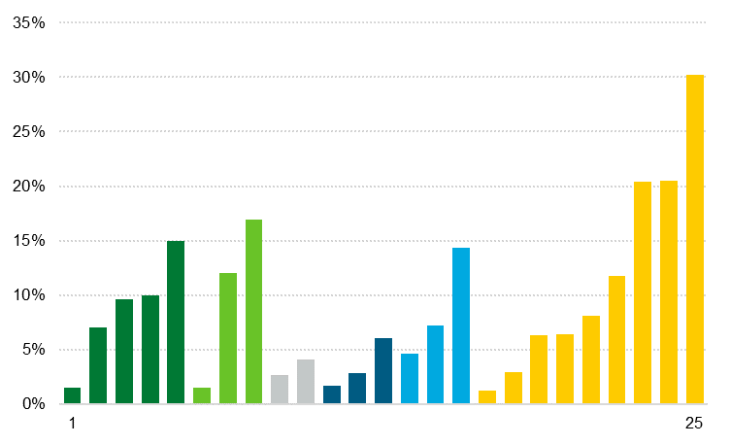
Small C&I customers were also shown to respond to TVRs but the evidence is more limited
TOU
TOU w/ Tech
CPR w/ Tech
CPP
CPP w/ Tech
VPP w/ Tech
Peak Reduction
Pricing Treatment
Source: Results from 4 pricing pilots and 25 individual treatments in these pilots. Con Edison’s Innovative Pricing Pilot (2019-2020) was also reviewed but the small C&I impacts were not statistically significant.

Slide 28
Key lessons learned during the past two decades of TVR deployment
  Based on evidence from nearly 400 tests of TVRs, residential customers respond to TVRs by reducing their peak usage
  Price response is directly related to peak to off-peak price ratio, rather than the type of TVR being tested
  Residential customers are most price responsive as a % of peak usage compared to the small C&I customers
  Enabling technologies such as smart thermostats increase the load impacts by up to 100% based on the pilots that tested both
  Default rate offerings produce lower impacts per participant, but larger impacts in the aggregate (holding the rate design constant) due to the higher enrollment level
  While there is some evidence that TVRs may result in overall conservation, the evidence is not conclusive
  Most of the time-varying rates were piloted/offered in summer-peaking climates; the evidence for winter response is limited
  Understanding winter price response will become exceedingly important with heating electrification, and summer-peaking systems starting to switch to winter-peaking systems
  Rate coaching and frequent feedback offered with TVRs is expected to improve customer response and experience. Effectiveness of these programs are typically not evaluated.

Slide 29
3 – Designing EPE’s TVR Pilot

Slide 30
Pilot Objectives
  System cost minimization: Reduce costs to serve customers by improving capacity utilization, encouraging economic conservation and peak shaving.
  Customer choice: Offering customers options to help them manage their energy bills.
  Equity and accessibility: Design and offer rates and programs that consider needs and effects on low-income/vulnerable populations
  Realization of AMI benefits: Provide an opportunity for customers to realize customer-facing benefits of AMI
  Renewables integration: Investing in and successfully and economically integrating renewable resources to help EPE meet its RPS goals

Slide 31
What are we expecting to learn from the pilot?
  The TVR pilot will provide valuable insights regarding customers’ ability, willingness, and experience as it relates to responding to price signals to shift load away from system peaks, thus reducing system costs.
  Whether EPE customers will show interest in the TVRs and once they are on the rate will they respond to the price signals by modifying their electricity consumption
  Based on the load impacts quantified in the pilot, whether EPE can expect meaningful peak demand savings if deployed at a larger scale
  Low income customer responsiveness and impact
  Small business customer responsiveness and impact
  Whether the price response persists over the course of the pilot
  Effectiveness of customer outreach, education and support
  Whether EPE customers were satisfied with the TVRs as they experience it

Slide 32
High-level Design Elements for the Pilot
  Once we receive input from this group, we will develop a pilot design that will allow testing a few TRVs for residential and small C&I customers
  We will design a statistically valid pilot that will allow EPE to generate internally and externally valid results to inform a potential larger scale deployment
  Pilot design will also involve developing an EM&V plan for load impact and process evaluation
  EPE will plan to undertake focus groups and surveys to understand customer understanding of and response to these rates
  EPE is committed to incorporating stakeholder feedback throughout the development of the pilots in the next several months

Slide 33
Discussion Questions
  Which rate design objectives should be prioritized by EPE in designing the TVRs?
  Which TVR options would best meet the objectives of the pilot?
  Which customer groups are important to analyze separately through this pilot?
  Is it important to test the impact of enabling technologies (i.e. smart thermostats) in these pilots?
  How should the rates be offered to the pilot customers: opt-in or opt-out?
  How do you define a successful outcome for this TVR pilot initiative?

